Slide 1

The Digital Divide in South Carolina Public Schools

Slide 2
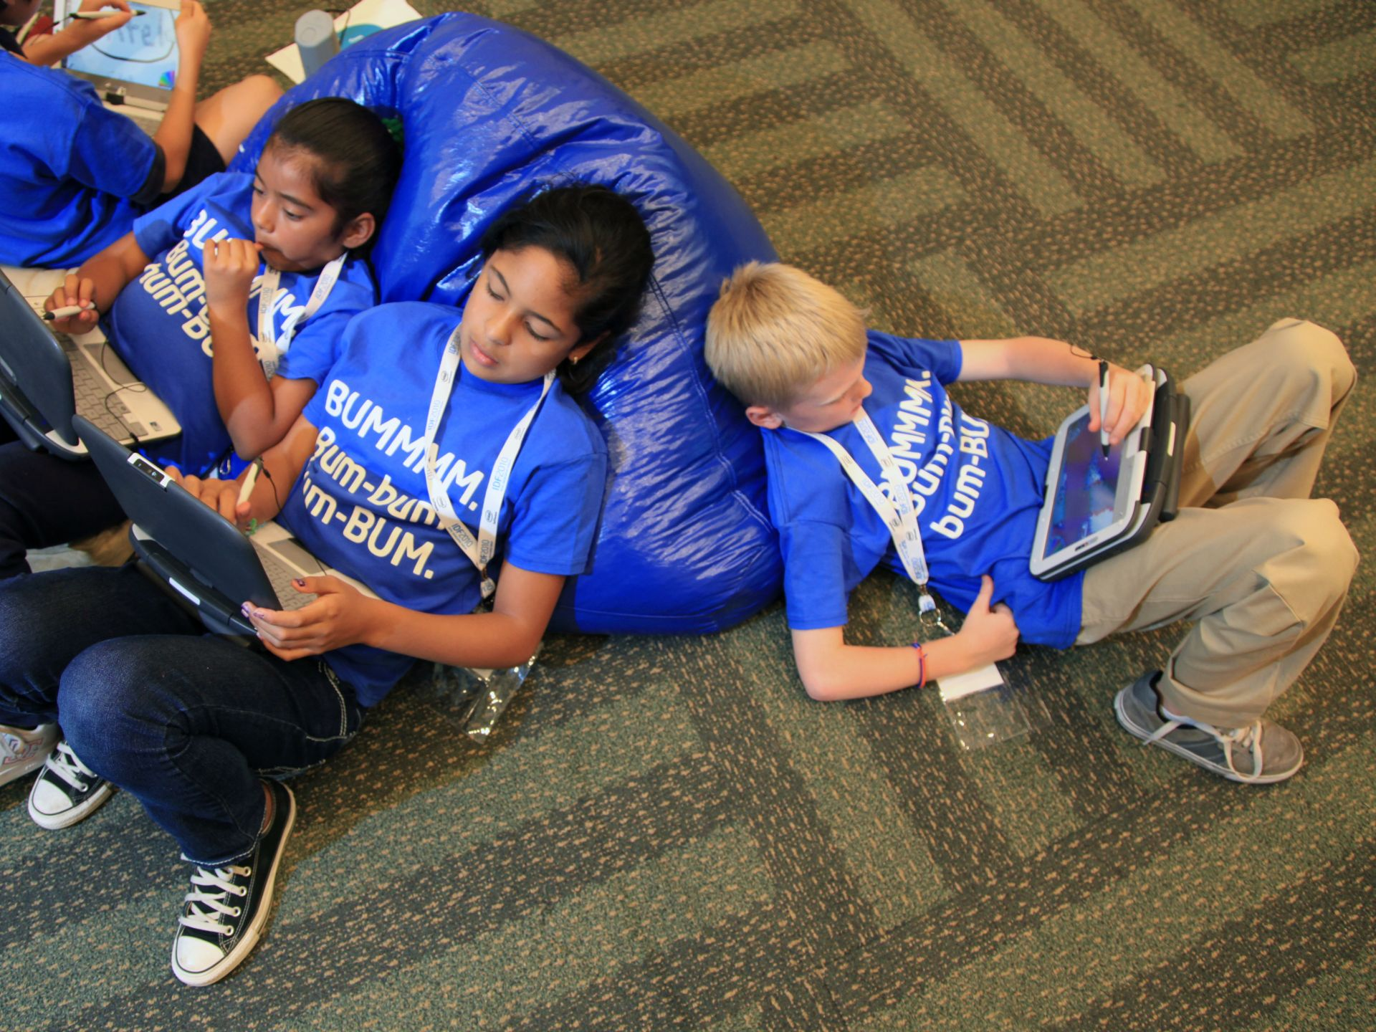
What Covid-19 Closures Exposed
When the state of South Carolina closed all public schools on March 15, 2020, the ensuing switch to all-remote learning exposed the already present vast digital divide within the state.
Since that time, much data has been collected and analyzed to give a broad and clear picture of what challenges are present in our mission to ensure an equitable educational experience for all our students.
This Photo by Unknown Author is licensed under CC BY-SA

Slide 3
South Carolina Statistics from May 14, 2020 Statehouse Report:
2/3 of public school students in SC are considered to live at or below poverty level.
According to the US Census Bureau, in 2019 it was estimated that 290,601 households in SC are without internet access.
Approximately 18% of teachers did not have the resources needed to implement online distance learning (devices and/or home internet access) during closures.
8% of districts had to rely solely on paper packet distance learning, while the other 62 districts offered hybrid paper/online or fully online remote learning during closures.
1 in 3 students was allowed to take a device home to participate in e-learning.
The state estimates it needs 64 million dollars to purchase an additional 160,000 devices to ensure each student has access to a tablet or laptop.
All 85 school districts have at least some areas within their boundaries that do not have access to broadband internet.

Slide 4
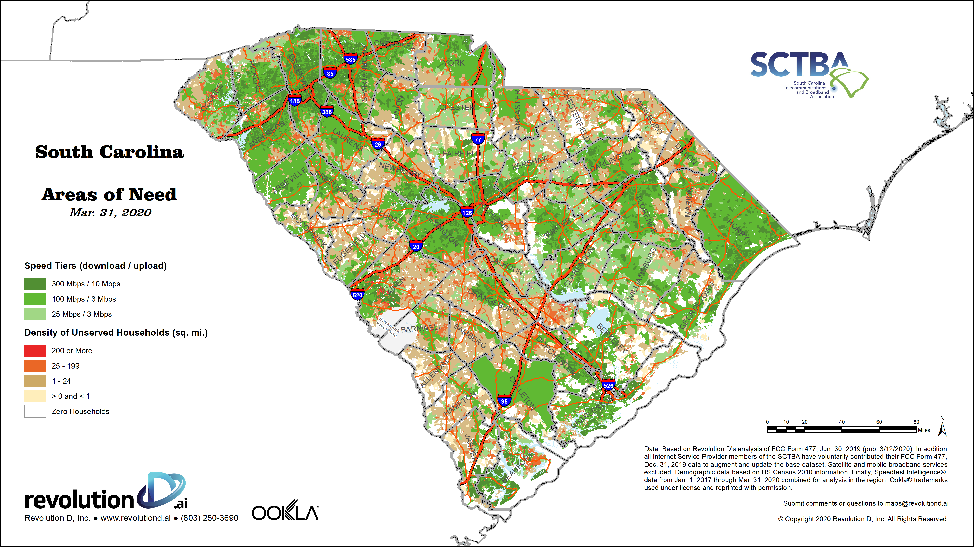
Broadband areas of need in SC as identified in
March of 2020
Students located in areas with a color other than green have a high density of unserved households.
Several school districts, including those in Barnwell, Allendale, Bamberg, and Marlboro are severely lacking in online access.
During Spring 2020 Covid closures, 30 of 85 school districts in SC had to depend mainly on paper packets due to lack of reliable access.

Slide 5
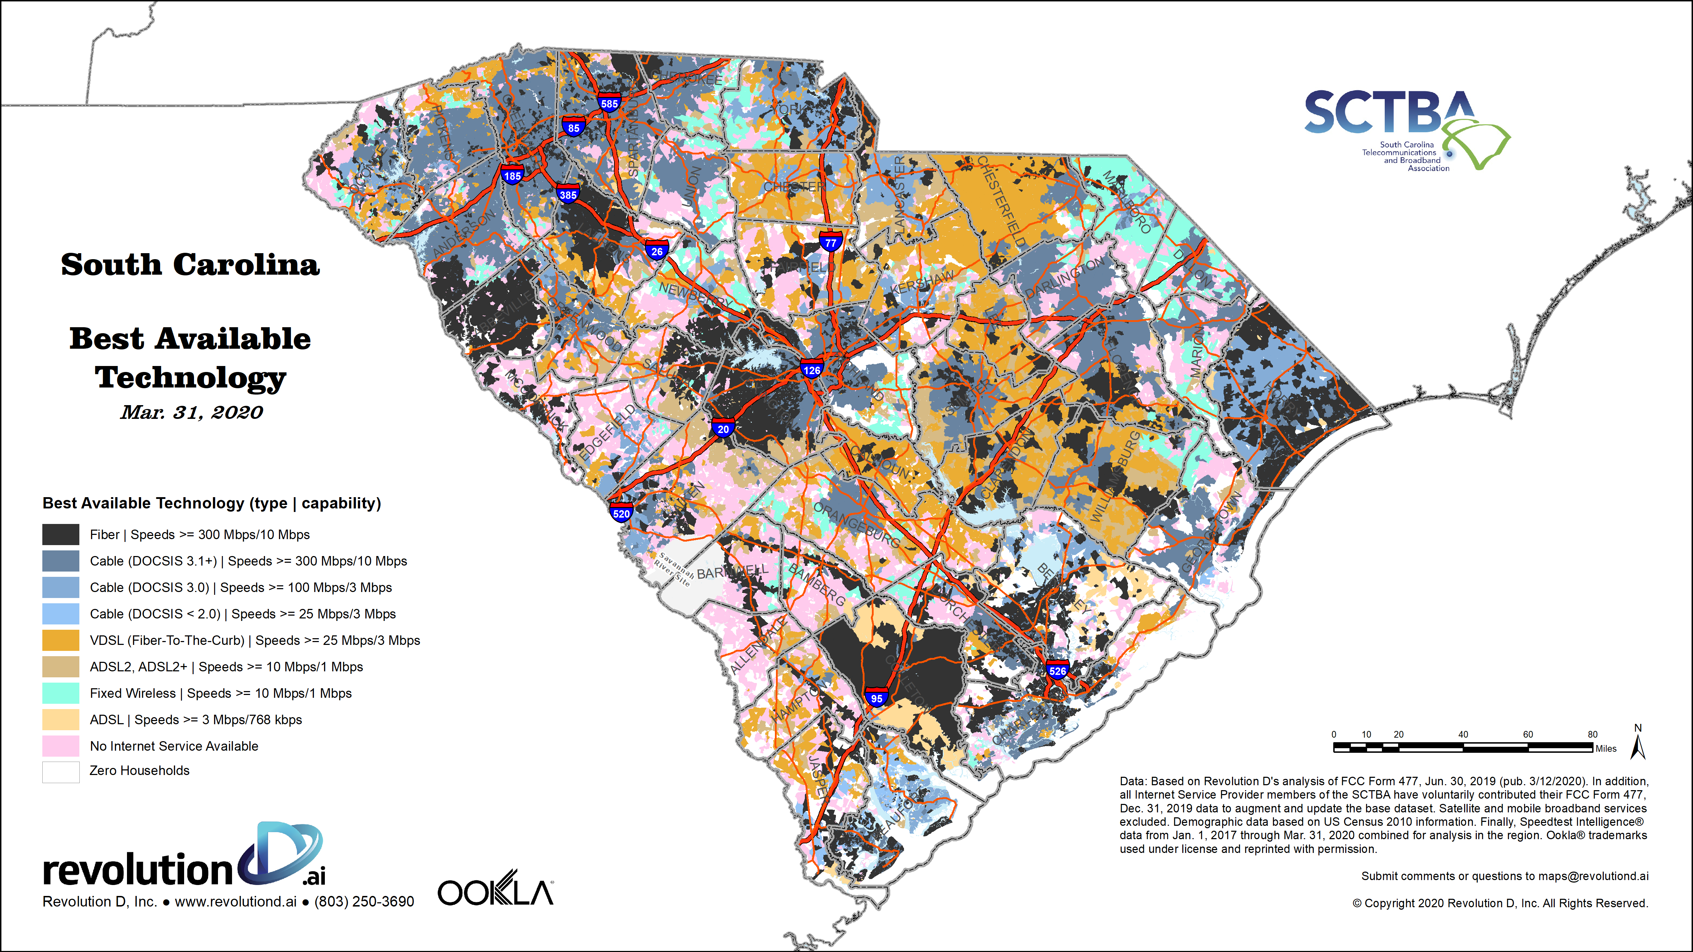
Best Available Technology in SC as identified in
March of 2020
Students in areas with darker colors have access to better/faster internet access.
These areas generally correspond to cities and more populous areas.
During Covid closures, only 19 of 85 SC school districts had access to fully “in depth online learning”.
Areas in pink have no internet service available at all.

Slide 6
Strategies for New Teachers
Be aware that many of these infrastructure issues such as broadband internet access are beyond the purview of local school boards to implement. Advocate for the community needs to local and state government officials.
Do your research on the community where you teach to determine what resources are lacking. You may also want to survey your students to determine which to do not have home internet access.
Offer choice options so students can choose a low-tech version of the same assignment, particularly if work will be expected to be completed at home.
Use programs that can be accessed via mobile phone. Some families only have internet access through their phones. But, be aware that access may also be limited on cell phones.

Slide 7
Strategies for New Teachers (continued)
Provide a list of local businesses that offer free wifi.
Advocate for community partnerships with local businesses on efforts to provide or subsidize access, such as through sponsoring internet hub buses in internet lacking communities.
If technology is an integral part of your instruction, make sure you offer enough time during class for implementation. When possible, save technology for in classroom instruction and do not require it for at home work.
Remember, technology alone is a supplement to but not a replacement for high quality instruction provided by a certified teacher. Do not be discouraged if you must modify plans occasionally to reduce or eliminate technology use. Focus on your students and how to best meet their needs.

Slide 8
References
NEW: Digital divide among chief concerns before fall semester. (n.d.). Retrieved July 21, 2020, from https://www.statehousereport.com/2020/05/14/new-digital-divide-among-chief-concerns-before-fall-semester/
Rary, K. (2020, April 22). Internet access a concern for distance learning in S.C. Retrieved July 21, 2020, from https://www.wtoc.com/2020/04/22/internet-access-concern-distance-learning-sc/
Raven, J. (2020, May 22). How the COVID-19 is magnifying South Carolina's 'digital divide'. Retrieved July 21, 2020, from https://www.wistv.com/2020/05/21/how-covid-is-magnifying-south-carolinas-digital-divide/
SC Digital Drive. (n.d.). Retrieved July 21, 2020, from https://www.scdigitaldrive.com/
Wood, A. (2020, May 28). 7 News Special Report: The Digital Divide in South Carolina. Retrieved July 21, 2020, from https://www.wspa.com/news/top-stories/7-news-special-report-the-digital-divide-in-south-carolina/

